Slide 1
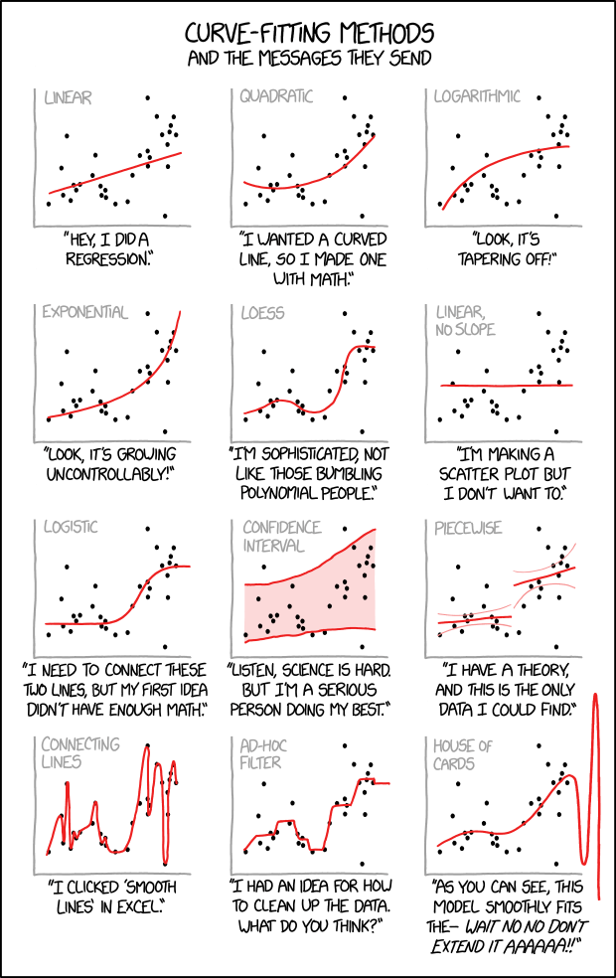
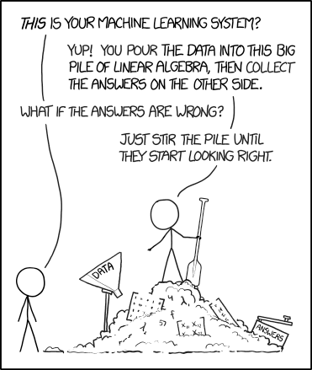
Machine learning
Classification and Supervised Learning
https://xkcd.com/1838/
https://xkcd.com/2048/

Slide 2
Topics
Introduction: GUI and basic calculations
Coding 1: Scripts, style, and variable classes
Coding 2: Control statements and loops
Visualization 1: Basics, subplots, get and set
Coding 3: Functions
Visualization 2: Descriptive plots
Coding 4: Basic input and output
Visualization 3: Distribution and 3D plots
Coding 5: Input and output specials – last lecture before holidays
Machine Learning 1: Introduction and dimension reduction
Machine Learning 2: Clustering
Machine Learning 3: Classification
Coding 6: Efficiency and debugging basics
Coding 7: Advanced functions and debugging

Slide 3
Supervised Learning
Learn a function that maps an input to an output based on training data by minimizing the output error
Each training data point consists of an input vector and an associated output (supervisory signal)
The learned function can be tested using a new test dataset (test whether the classifier generalizes well)
If the output is continuous, it‘s a regression task, if it‘s categorical, it‘s a classification task

Slide 4


Considerations
Bias-Variance tradeoff
Do different, but equally good training datasets lead to equal results?
An algorithm must be flexible, but should not overfit
Noise in the data
Noisy data with potentially inaccurate output can only lead to bad classification results (GIGO: Garbage in – Garbage out)
Dimensionality and classifier complexity
Less is less risky (same as with clustering)
Heterogeneity, Redundancy, Non-Linearities

Slide 5
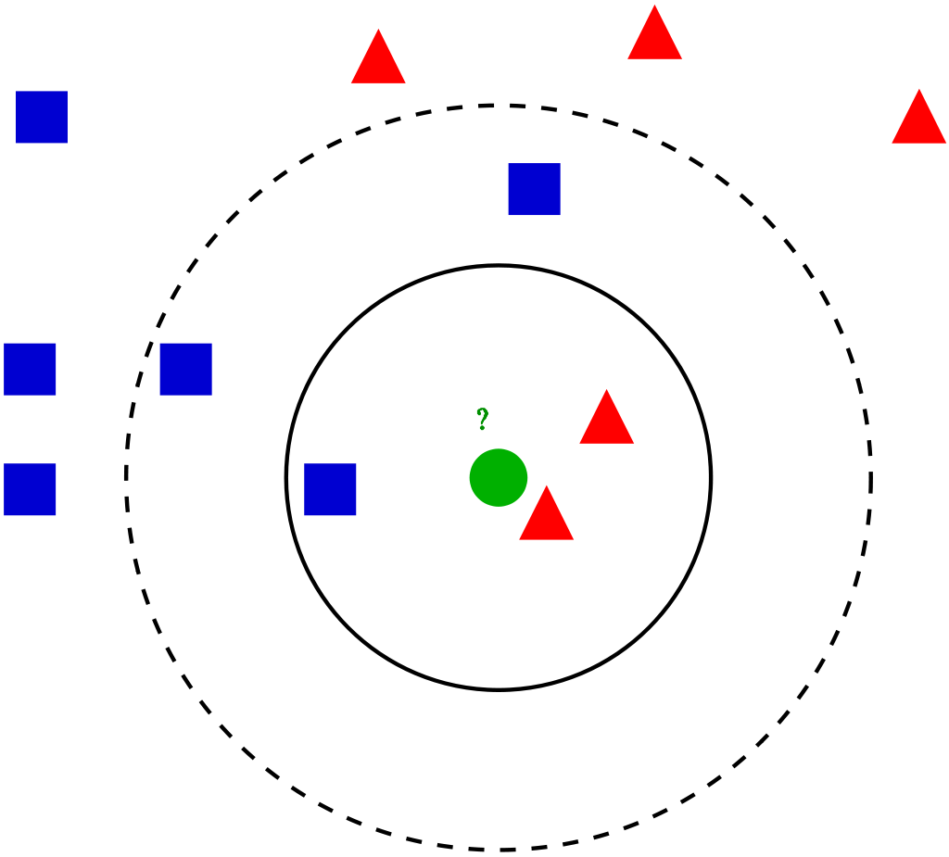
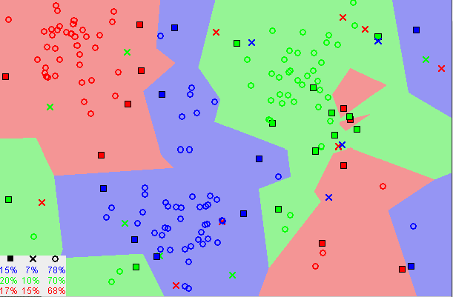
K-Nearest Neighbors
Maybe the simplest ML algorithm
Lazy Learning: Computation is actually done only upon classification, and only locally
Simplest case: Classification result is just the same as the class of the nearest neighbor
Parameters
The number of neighbors (k)
Distance function
Weights for the k neighbors
Nonlinear
https://en.wikipedia.org/wiki/K-nearest_neighbors_algorithm

Slide 6
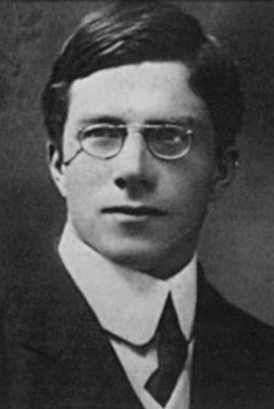
Linear Discriminant Analysis
Finds a linear combination of features (weights, like PCA) that separates known classes
Developed by Sir Ronald Fisher (1890 – 1962)
The guy with the flowers (the iris dataset was an example dataset for LDA!)
Statistics genius, also created ANOVA, F(isher)-distribution, Student‘s-t distribution
Kind of a racist though (eugenics…)
Assumptions
Multivariate normality
Homoscedasticity (all features have the same variance)
Independence (data points are randomly sampled)
Can also be used for dimensionality reduction
https://en.wikipedia.org/wiki/Ronald_Fisher

Slide 7
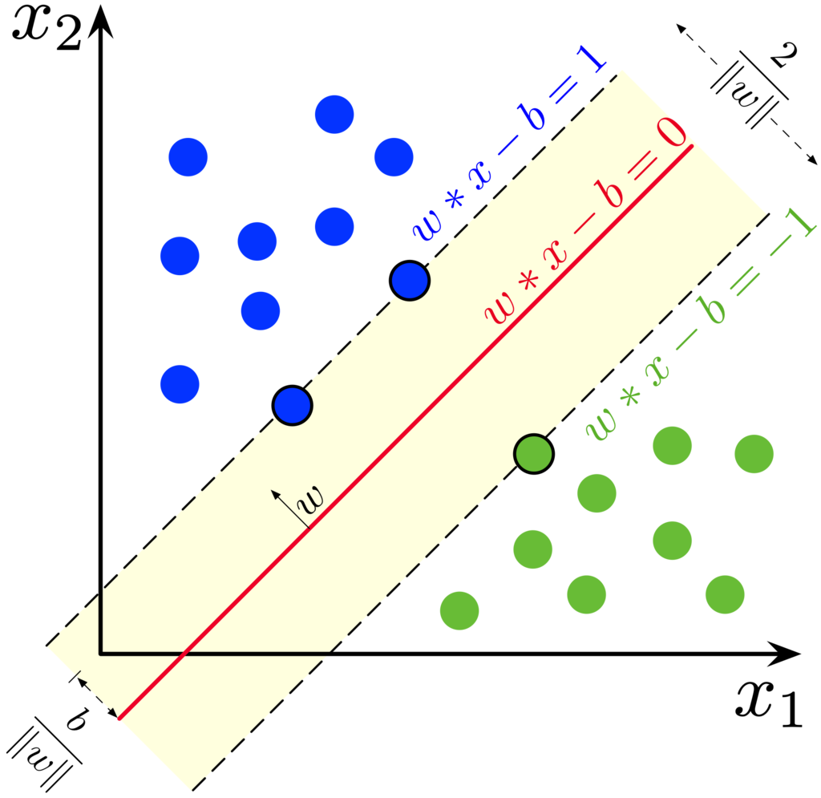
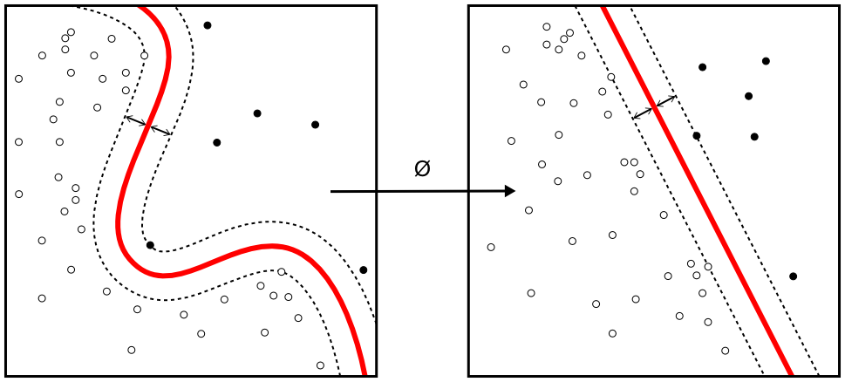
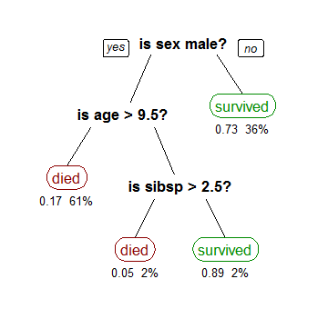
Other Algorithms
Support Vector Machines
Are no machines.
Finds a set of support data points that define the decision boundary between two classes with a maximal margin between them
By using a mathematical trick (nonlinear kernels) it‘s possible to have them work nonlinearly
Decision Trees
Splits the data into subsections based on decisions about their features
Can be interpreted by humans
Can be very non-robust to changes in the data
Learning such a tree takes a while so heuristcs are used
And a bazillion more.
https://en.wikipedia.org/wiki/Support-vector_machine
https://en.wikipedia.org/wiki/Decision_tree_learning

Slide 8
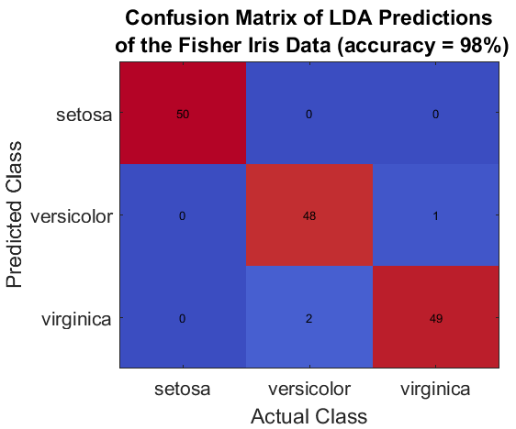
Confusion Matrix
Table that visualizes the prediction in contrast to the actual class
Rows = Predictions, Columns = Actual Class
Well, it doesn‘t really matter, but stick to the convention… you can remember it by the y-axis being dependent on the x-axis, like in a function
Signal-detection-theory can be applied
True-positive (sensitivity of a class, e.g. „versicolor“) = #hits (48)/#data (50) = 0,96
Accuracy (overall) = summed true-positive (147)/ # all data (150) = 0,98
Very simple tool, but powerful and useful for visualization

Slide 9
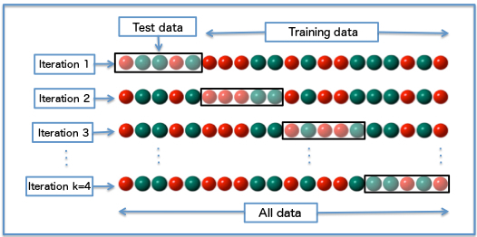
Cross Validation
Try to asses the performance of a classifier and how well a classifier generalizes (bias vs variance)
In practice you don‘t just have a test dataset…
Split the training data into subsets (folds, often 5 <= k <= 10)
Use one of the folds as test dataset, repeat k times
Compute mean accuracy over all folds
https://en.wikipedia.org/wiki/Cross-validation_(statistics)

Slide 10
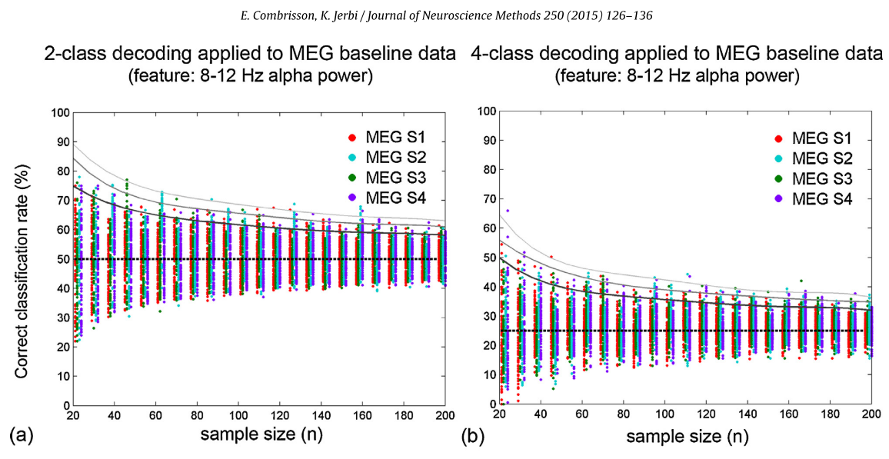
Chance Level
Chance level is not just 1/k (e.g. 50% with two classes)!
This is the case only with infinite amount of data
It‘s also different if the classes do not have the same amount of data
E.g. class 1 has 10 data points, class 2 has 500 -> a classifier that always predicts class 2 has high accuracy but is useless
Permutation-based (or binomial-distribution) statistics can be used to compute an actual statistical significance level
Shuffle the data around very often and see how often you get accurate by chance

